Slide 1
Traffic detection and monitoring with traffic camera
Timo Tiirats
Xuejun Wu
Denys Kolomiiets

Slide 2
Project description
Try to analyse lcameras on the road to understand traffic patterns, such as traffic counting and traffic density

Slide 3
Methodology
Background subtraction
Haar Cascade
YOLO

Slide 4
Background Subtraction
Filter to decrease noise
Two kind of background subtraction
Static background subtraction
Opencv subtractor

Slide 5

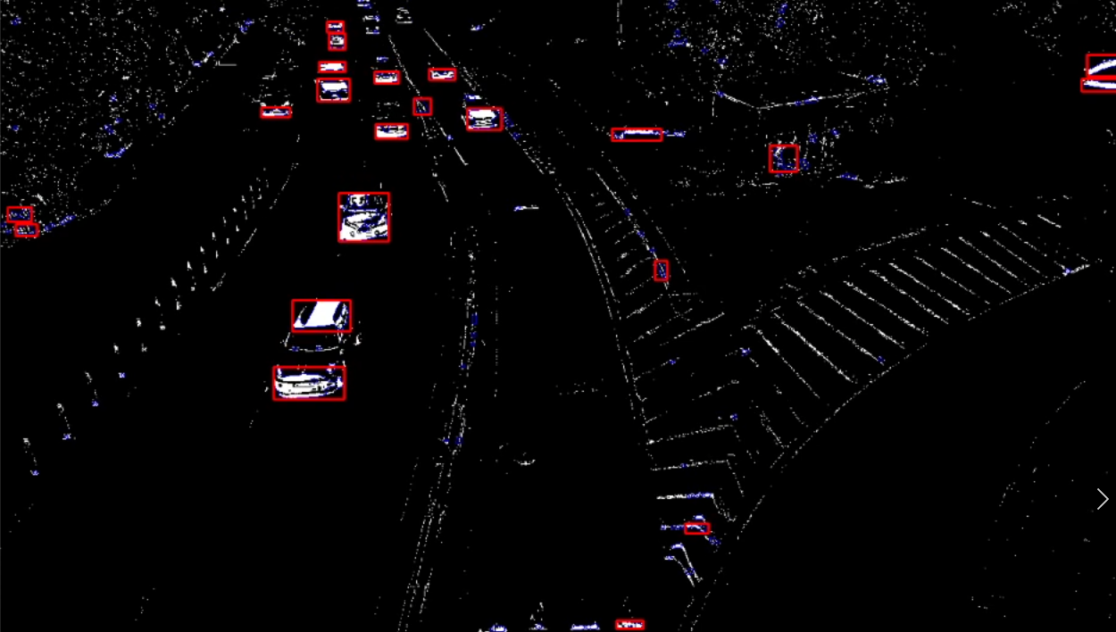
Static background subtraction
Calculate the average over 10 seconds
Mask and subtract
The noise is relatively low when camera is stable

Slide 6
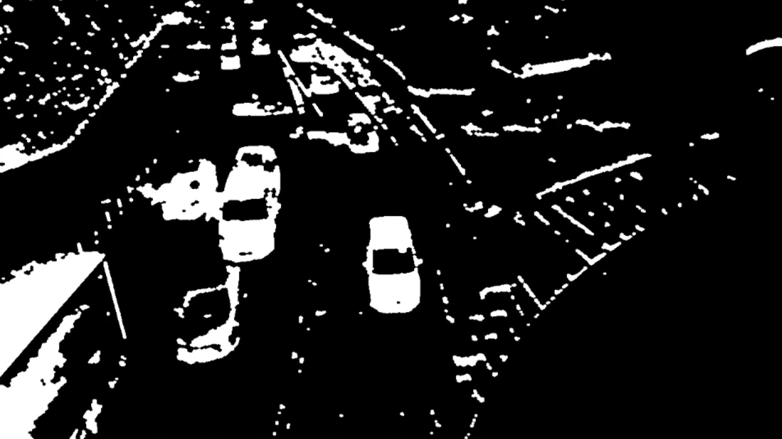
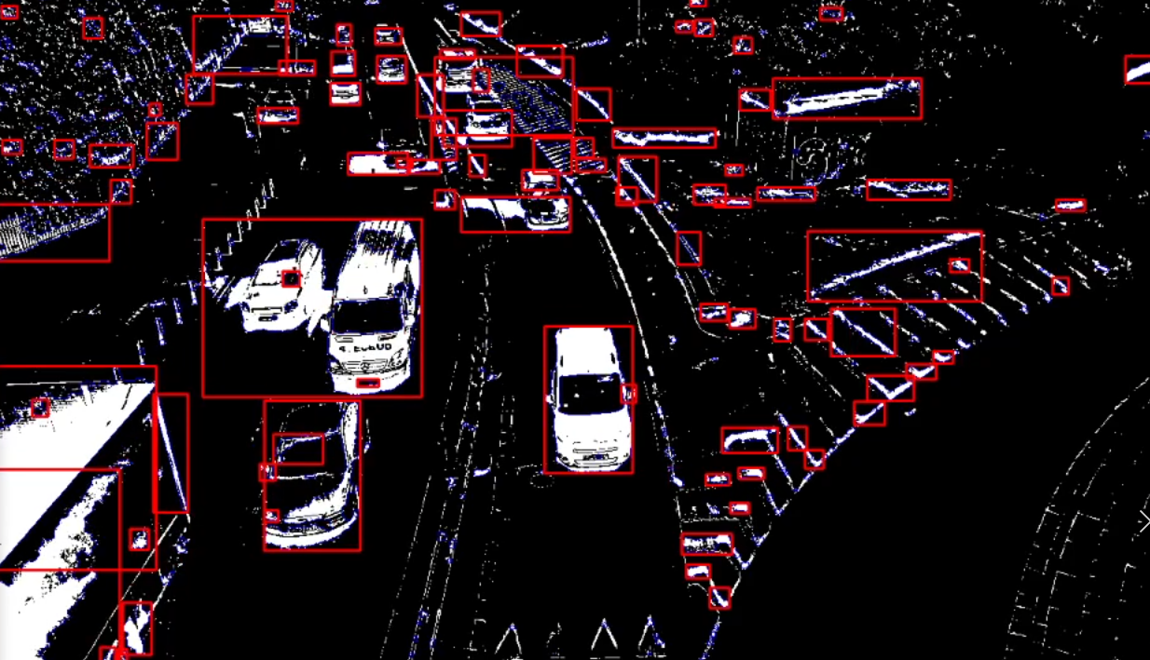
Static background subtraction
The noise increase when camera viberate
Yield bad result for clustering

Slide 7
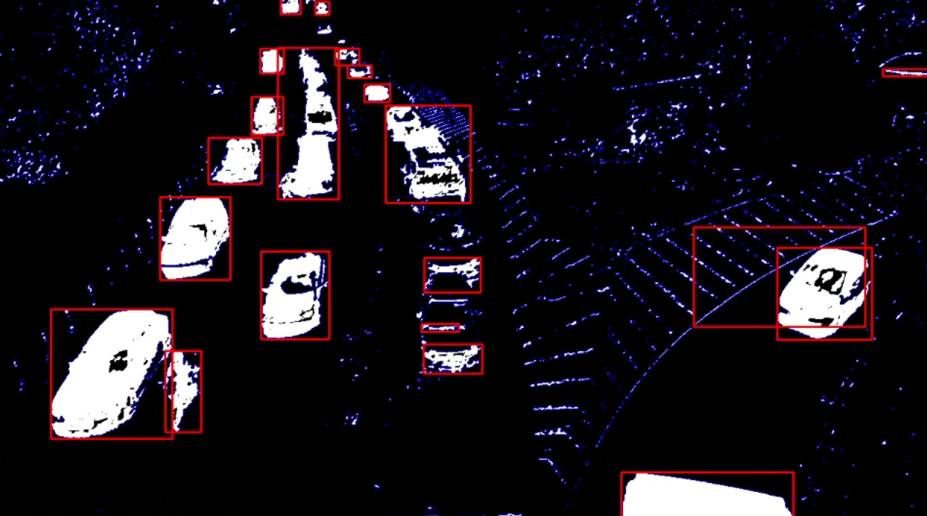
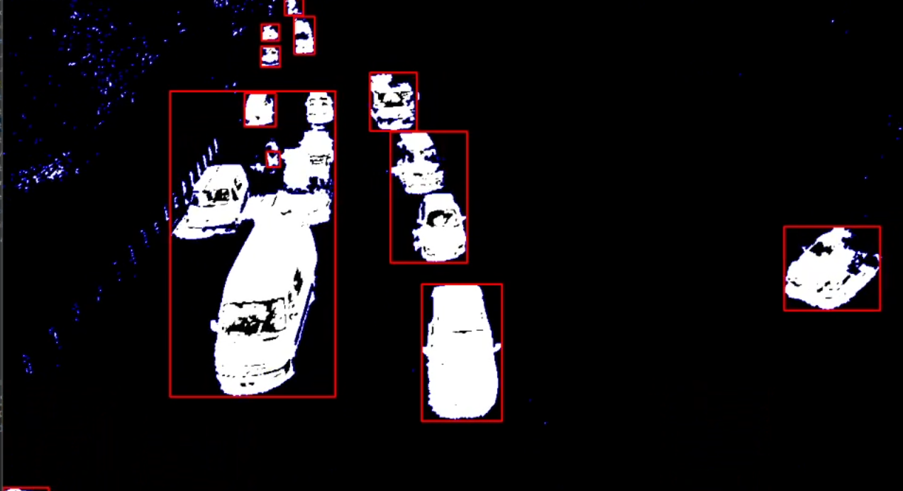
Background subtractor
The noise is reduced to an acceptable level
The identification of car is difficult in densed traffic

Slide 8
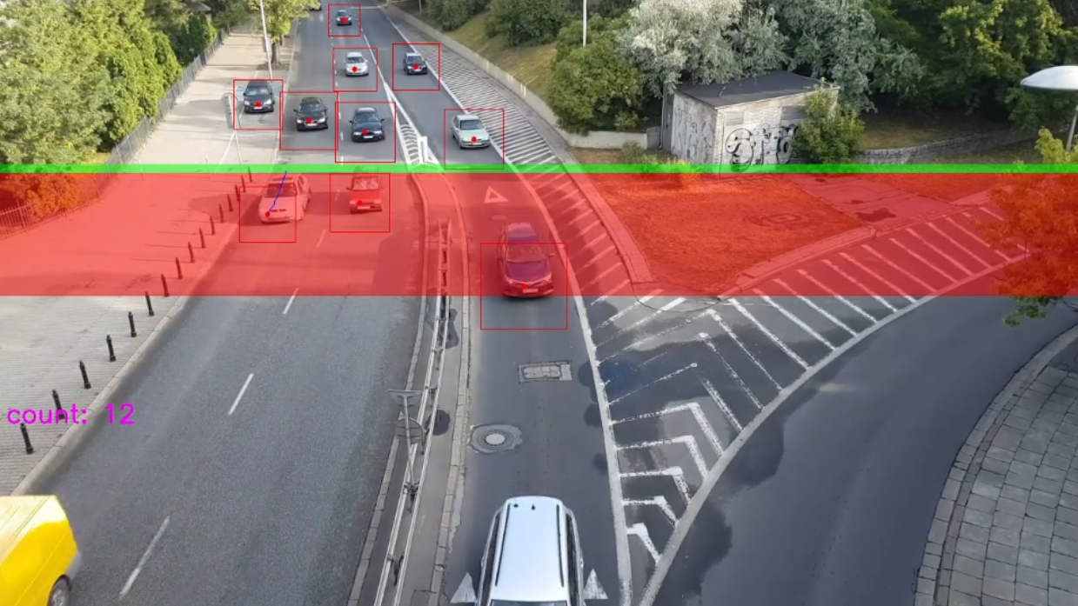
Haar Cascade
Find center
Add path(green)
Append path(red)
Increment counter
Delete incorrect path

Slide 9
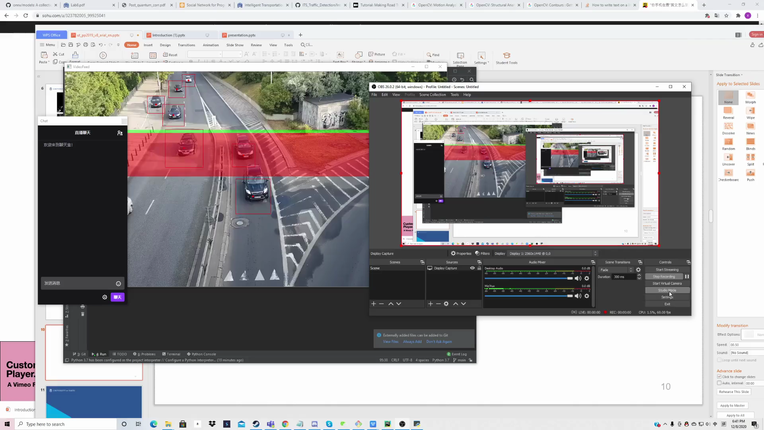
Haar Cascade

Slide 10
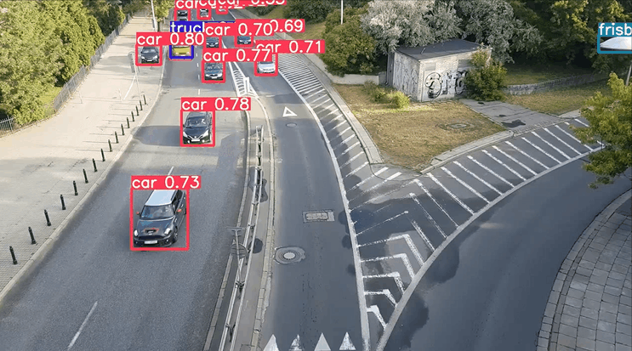
Object Detection

Slide 11
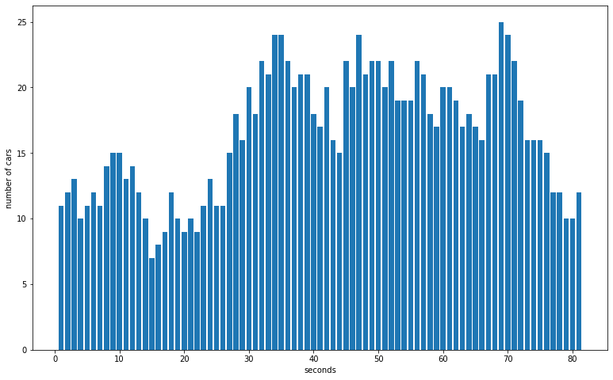
Results

Slide 12
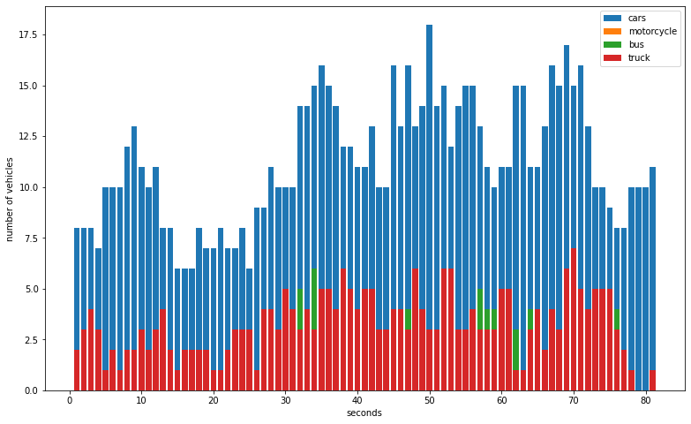
Added benefit

